Slide 1
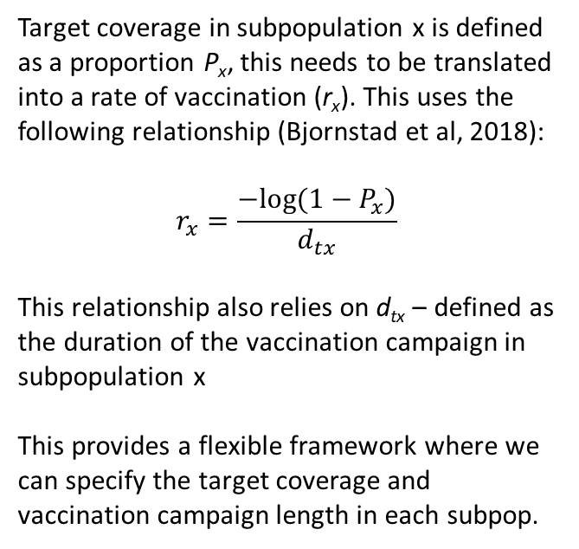
Parameter | Description
E_{ff} | Efficacy of Vaccination
r_{x} | Rate of Vaccination
β_{xy} | Per capita rate of transmission from infectious subpopulation y to susceptible subpopulation x
γ | Per capita rate of recovery
V_{i}
r_{i}·E_{ff}
S_{i}
β_{ii}
I_{i}
γ
R_{i}
Population i
β_{ji}
β_{ij}
V_{j}
r_{j}·E_{ff}
S_{j}
β_{jj}
I_{j}
γ
R_{j}
β_{ki}
Population j
β_{ik}
Target coverage in subpopulation x is defined as a proportion P_{x}, this needs to be translated into a rate of vaccination (r_{x}). This uses the following relationship (Bjornstad et al, 2018):
$$r_{x}=\frac{−log⁡(1−P_{x})}{d_{tx}}$$
This relationship also relies on d_{tx} – defined as the duration of the vaccination campaign in subpopulation x
This provides a flexible framework where we can specify the target coverage and vaccination campaign length in each subpop.
β_{kj}
β_{jk}
V_{k}
r_{k}·E_{ff}
S_{k}
β_{kk}
I_{k}
γ
R_{k}
Population k
We assume that vaccination will only take place in those who are susceptible and will permanently move them to compartment V.
Waning immunity can be modelled by introducing a “back” rate to the S compartment from V and R compartments

Slide 2
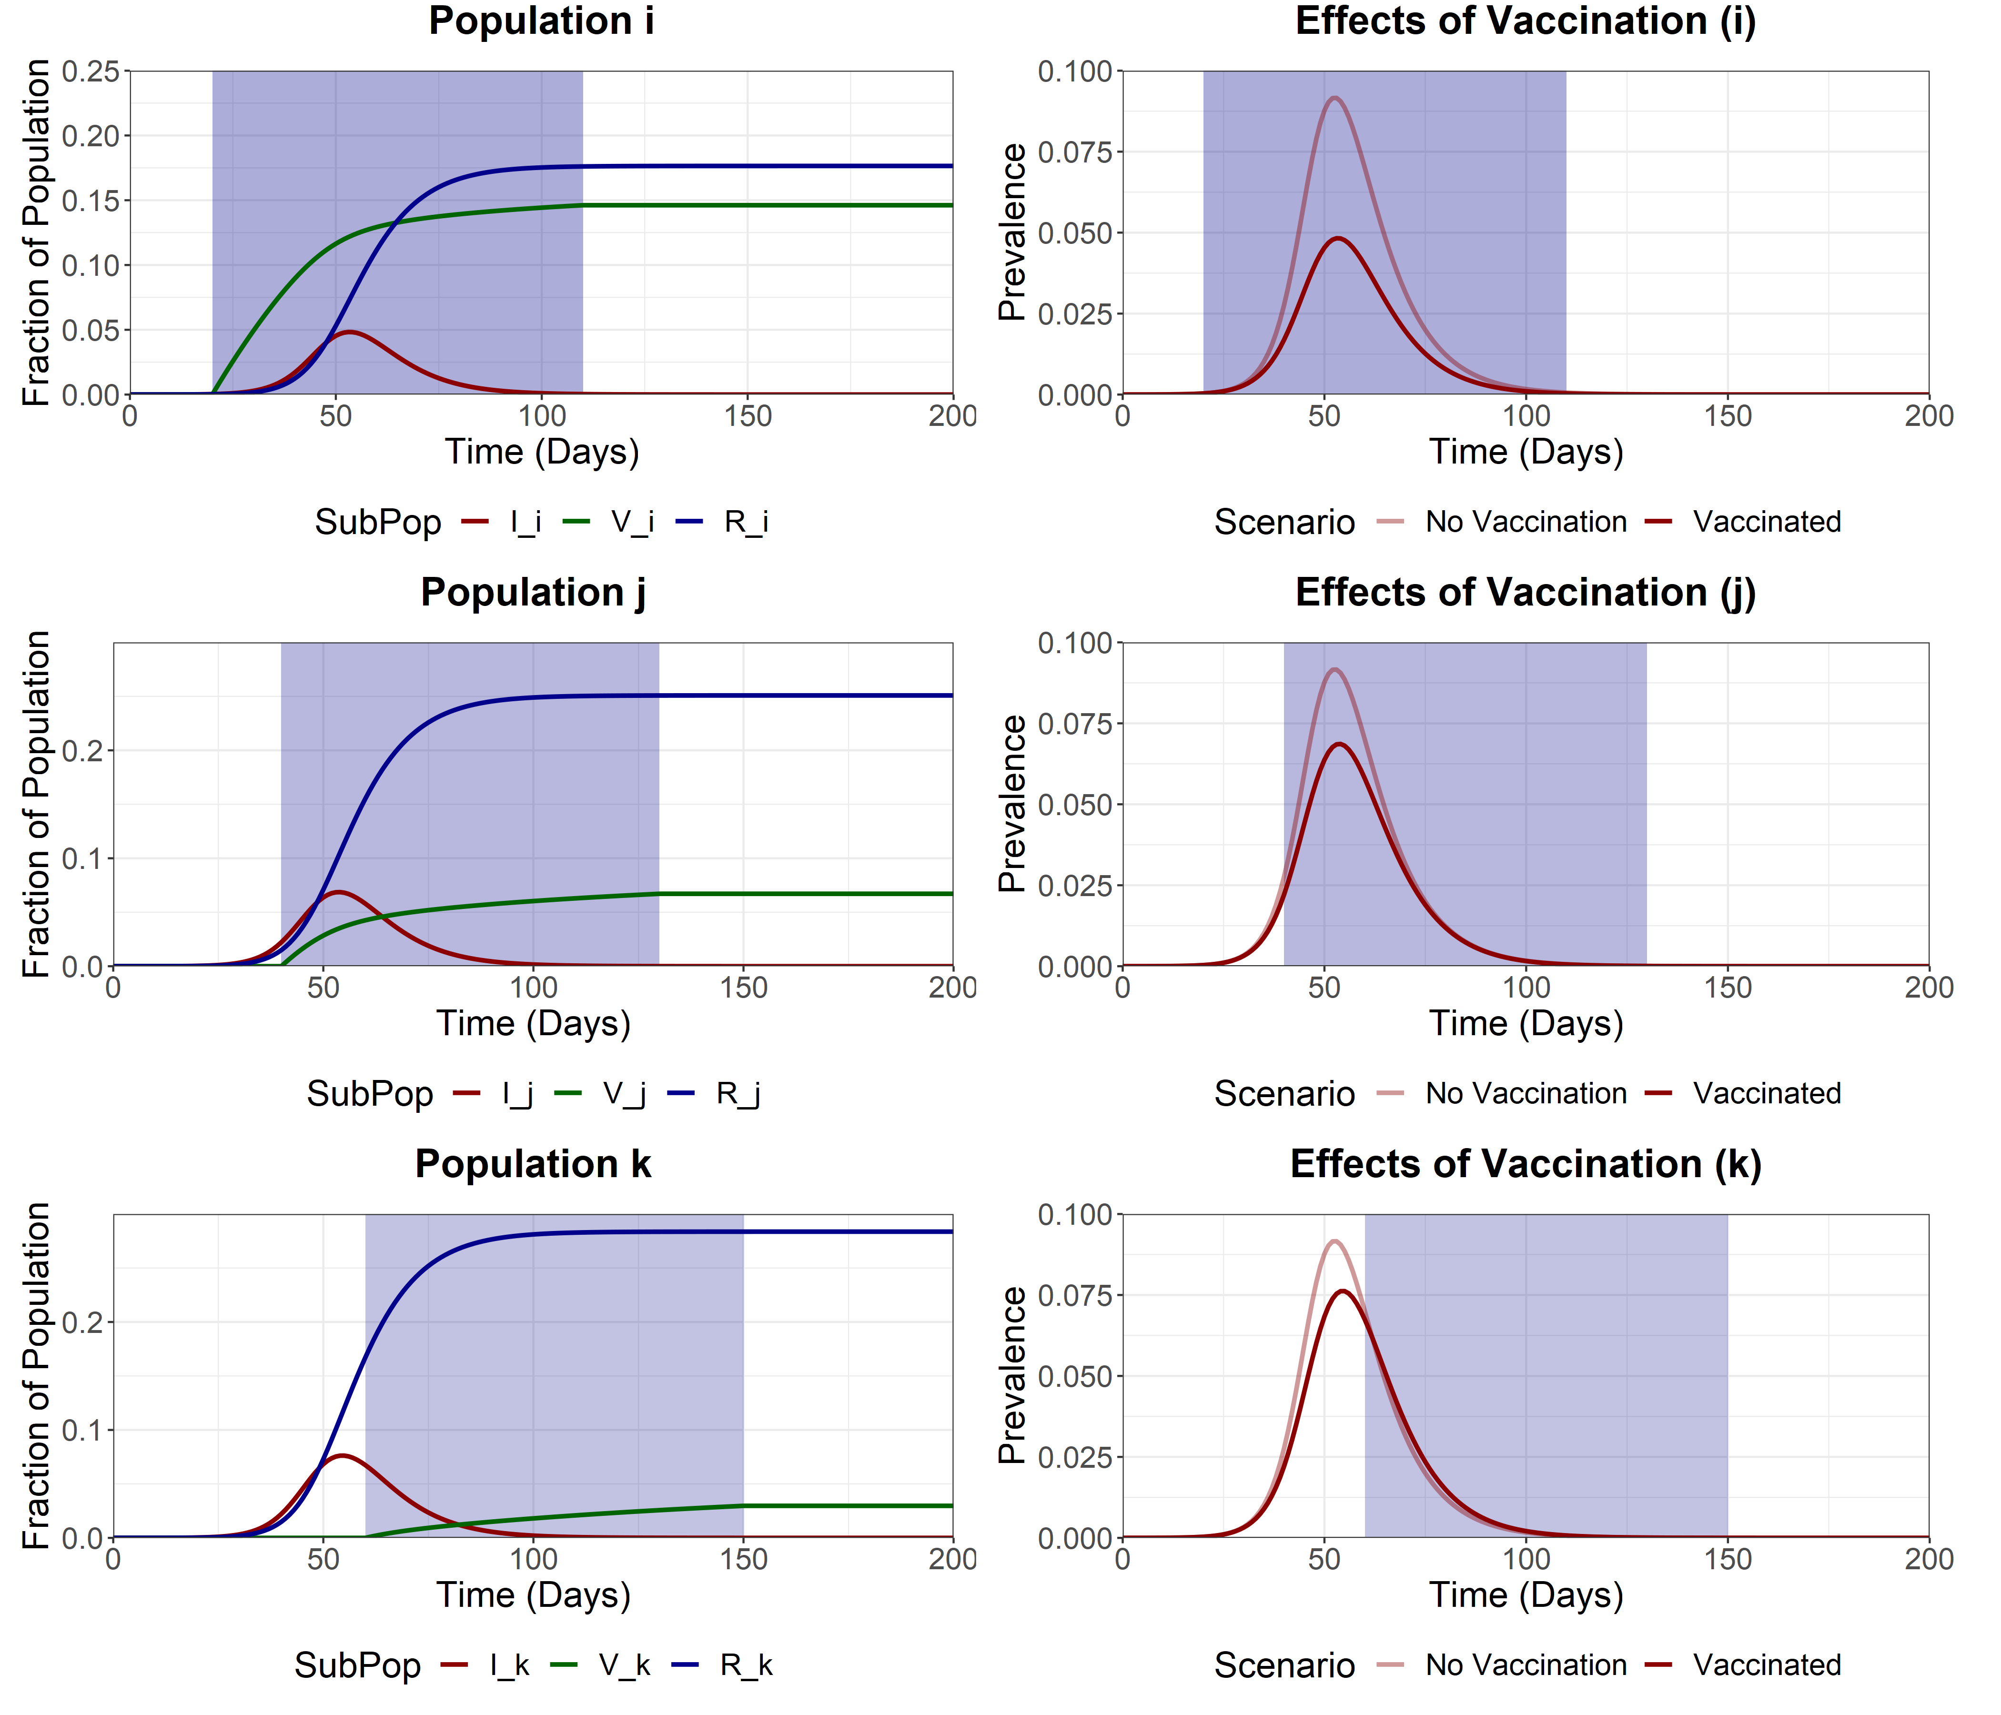
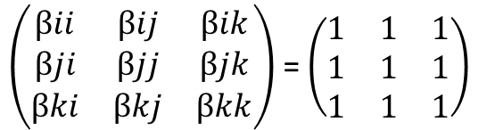
Baseline Analysis
We also allow for heterogenous mixing between subpopulations. Scaling for the analysis on the right provided below:
$\left(\begin{matrix}βii & βij & βik \\ βji & βjj & βjk \\ βki & βkj & βkk\end{matrix}\right)$= $\left(\begin{matrix}1 & 1 & 1 \\ 1 & 1 & 1 \\ 1 & 1 & 1\end{matrix}\right)$
As an example we provide a staggered vaccination campaign (efficacy of 90%) to provide differential coverage across subpopulations:
Subpopulation i
Target Coverage = 90%
Duration = 90 days
Trigger Date = day 20
Subpopulation j
Target Coverage = 80%
Duration = 90 days
Trigger Date = day 40
Subpopulation k
Target Coverage = 70%
Duration = 90 days
Trigger Date = day 60
Initial Conditions
S_{i} = 0.33333
S_{j} = 0.33333
S_{k} = 0.33333
I_{i} = 0.0000033
I_{j} = 0.0000033
I_{k} = 0.0000033
V_{i} = 0
V_{j} = 0
V_{k} = 0
R_{i} = 0
R_{j} = 0
R_{k} = 0
Trajectory plot for I, V and R compartments for each subpopulation
Effect of vaccination vs a scenario with no vaccination (Eff = 0) in each infectious (I) subpopulation

